Slide 1
Movie Recommendation System: NLP-Based Recommender System
Submitted by
22JK1A0543 KAITEPALLI NAGARAJU
22JK1A0527 BATTULA VISHNU
22JK1A0528 BIKKI VISHNU VARDHAN
22JK1A0529 RAHUL SAI BOJJANKULA
Under the Guidance of
K SRINIVAS REDDY
ASST. PROFESSOR
Department of Computer Science & Engineering
KITS AKSHAR INSTITUTE OF TECHNOLOGY
Affiliated to JNTU Kakinada
2025-26

Slide 2
Abstract
The Movie Recommendation System is an NLP-based recommender system that suggests movies based on user interests. It helps users easily find suitable movies from a large collection available on online platforms.
The system is developed using Python with libraries such as Pandas, NumPy, and Scikit-learn. NLP techniques like TF-IDF are used for text processing, and the project is implemented using Jupyter Notebook or Google Colab.
The process begins with collecting a movie dataset containing titles, genres, and descriptions. After preprocessing the data, TF-IDF converts text into numerical features and the KNN algorithm finds similar movies.
his project demonstrates how NLP and machine learning can be used to build an effective movie recommendation system and provide personalized movie suggestions.

Slide 3
Objectives:
The main objective of this project is to develop an NLP-based movie recommendation system that suggests movies based on their content. The system analyzes movie descriptions and genres using Natural Language Processing techniques. It uses TF-IDF and the K-Nearest Neighbors algorithm to identify similar movies and provide accurate recommendations to users.
Objectives of the Project:
Develop Recommendation System:
To develop a movie recommendation system that suggests movies based on user interests.
Apply NLP Techniques:
To apply Natural Language Processing techniques to analyze movie descriptions and genres.
Text Feature Extraction:
To convert movie textual data into numerical features using the TF-IDF method.
Similarity Based Recommendation:
To implement the K-Nearest Neighbors (KNN) algorithm to recommend similar movies.

Slide 4
Literature Survey:
International Journal of Advanced Computer Science and Applications, 2023, 14(2), doi:10.14569/IJACSA.2023.0140212
This work is licensed under a Creative Commons Attribution 4.0 International License.
Movie Recommendation System Using Machine Learning and Natural Language Processing
S. Kumar, R. Sharma, and P. Gupta
Department of Computer Science, Indian Institute of Technology, India
Abstract
Wit the rapid growth of online streaming platforms, users are often overwhelmed by the large number of movies available. Movie recommendation systems help users discover relevant movies based on their preferences. This research focuses on developing a movie recommendation system using Natural Language Processing (NLP) and machine learning techniques. The system analyzes movie descriptions, genres, and metadata to understand the similarity between movies. Techniques such as text preprocessing, TF-IDF vectorization, and cosine similarity are used to convert textual information into numerical features and calculate similarity scores. The proposed model helps users receive personalized movie recommendations based on their interests and previously liked movies

Slide 5
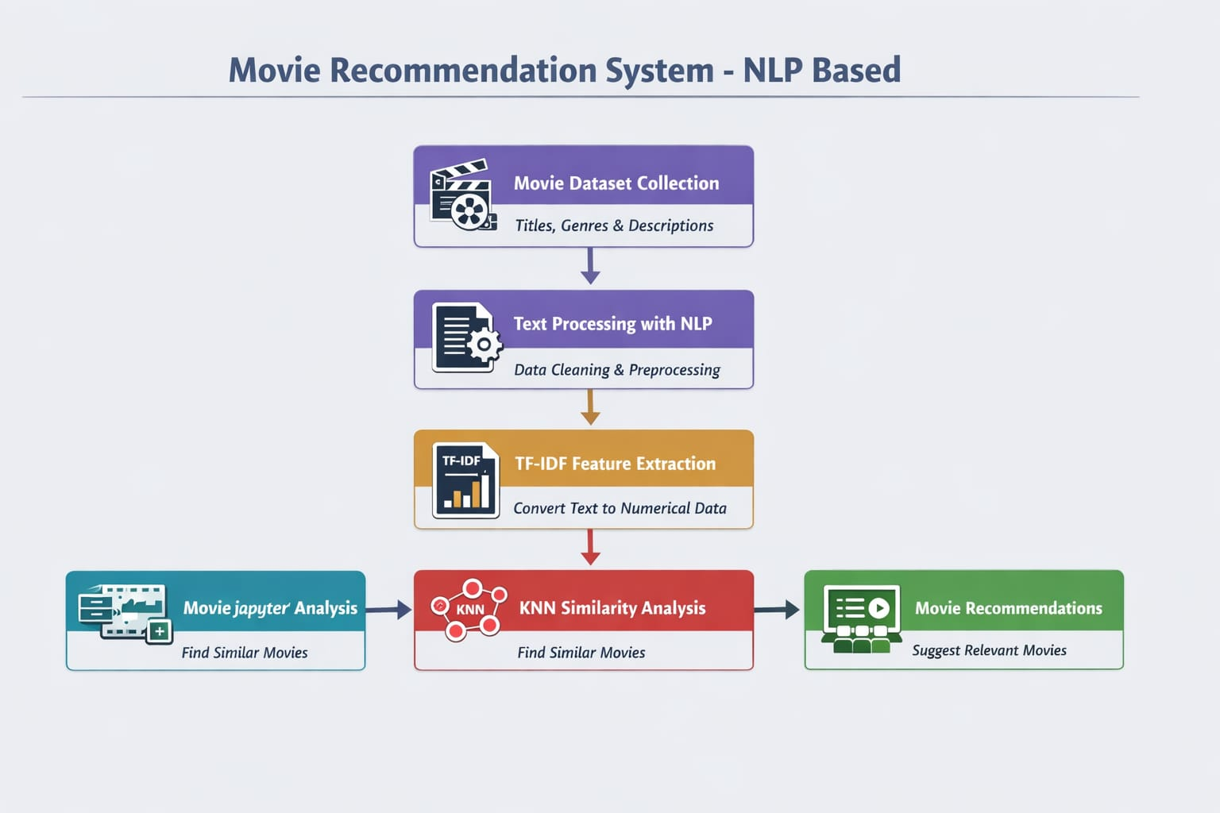
System Analysis :
Problem:
Users face difficulty selecting suitable movies due to the large number of movies available on online platforms.Manual searching for movies is time-consuming and often does not match user preferences.
Dataset Collection:
Movie titles, genres, and descriptions are collected from a dataset.
NLP Processing:
Text data is cleaned and preprocessed using NLP techniques.
TF-IDF Extraction: Text is converted into numerical features using TF-IDF.
KNN Recommendation:
KNN finds similar movies and recommends them to users.

Slide 6
Modules:
1.Dataset Collection Module:
This module collects the movie dataset containing movie titles, genres, and descriptions from sources like Kaggle. The dataset acts as the input for the recommendation system.
2. Data Preprocessing Module:
In this module, the movie data is cleaned and prepared by removing unnecessary words, punctuation, and missing values to make the dataset suitable for processing.
3. Feature Extraction Module:
This module converts movie descriptions into numerical features using TF-IDF, which helps the system understand the importance of words in the dataset.
4. Similarity Calculation Module:
The processed data is analyzed using the K-Nearest Neighbors to find movies that are similar to each other based on their features.
5. Recommendation Module:
This module generates and displays the final movie recommendations to the user based on similarity results.

Slide 7
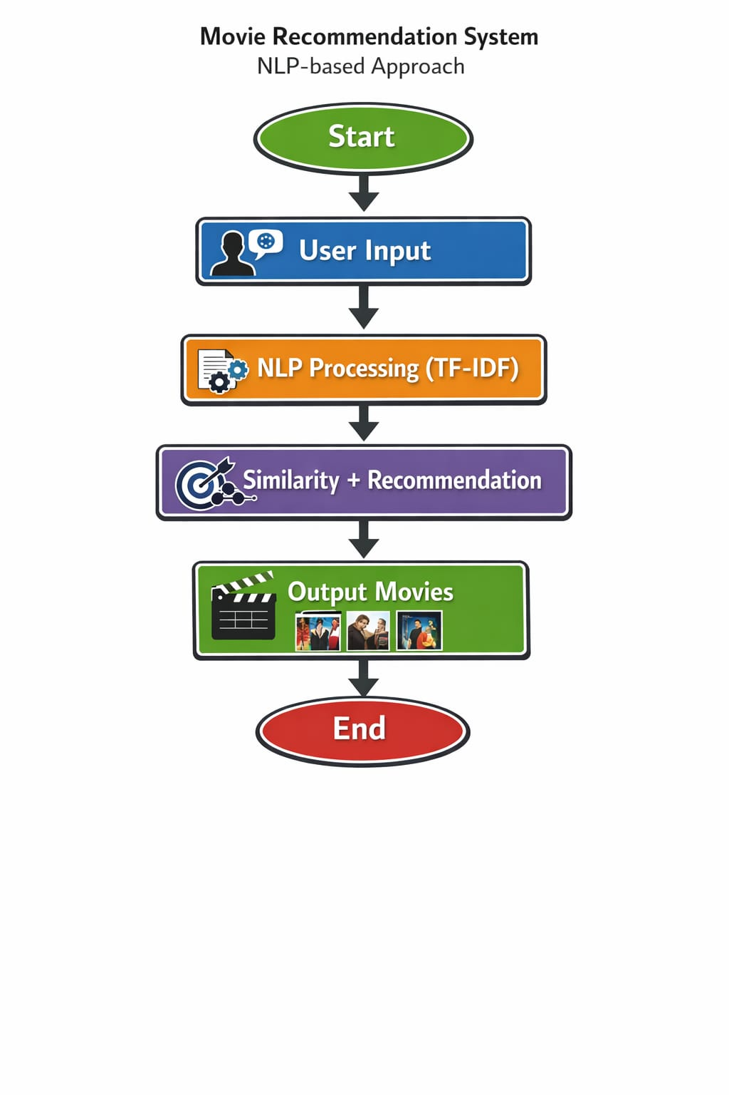
System Design:
Key Technologies used in the flow:
TF-IDF – converts movie descriptions into numerical vectors.
K-Nearest Neighbors – finds movies with similar features.

Slide 8
Implementation:
1. The system is implemented using *Python* in *Jupyter Notebook* or *Google Colab* with libraries like Pandas, NumPy, and Scikit-learn.
2. A movie dataset containing titles, genres, and descriptions is collected from *Kaggle* and loaded for processing.
3. The dataset is cleaned through preprocessing by removing missing values, punctuation, and unnecessary words.
4. *TF-IDF* converts movie descriptions into numerical features.
5. The *K-Nearest Neighbors* is used to find similar movies.
6. The system finally displays recommended movies based on similarity results.

Slide 9



